Slide 1





ArcGIS API for JavaScript: 2D Visualization
Kristian Ekenes & Jeremy Bartley
Notes:
G97350 UC Template for Esri staff

Slide 2


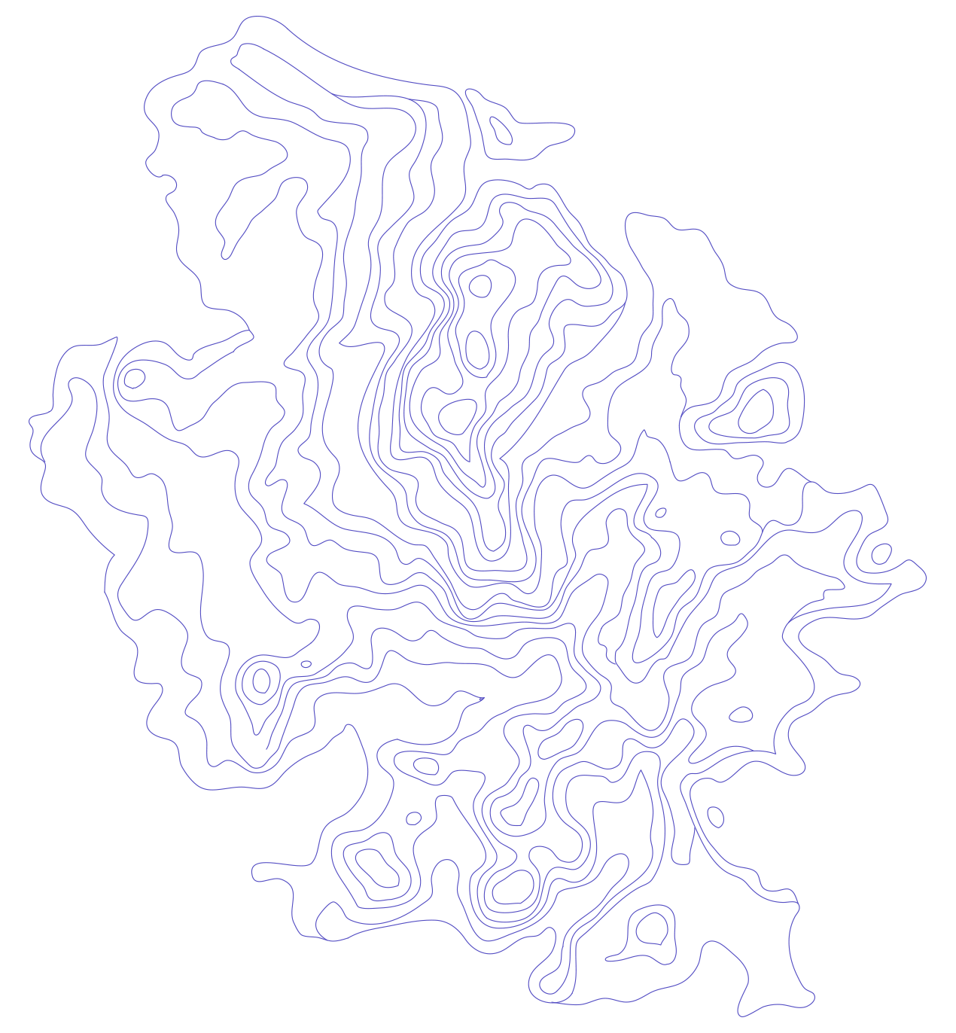


API Overview
Renderers, Symbols, etc.
Notes:
G97350 UC Template for Esri staff

Slide 3
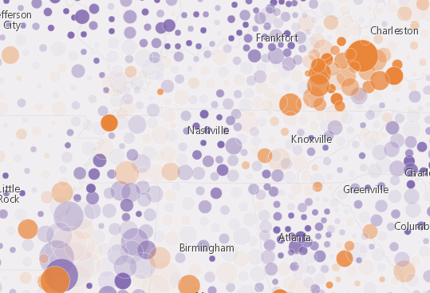
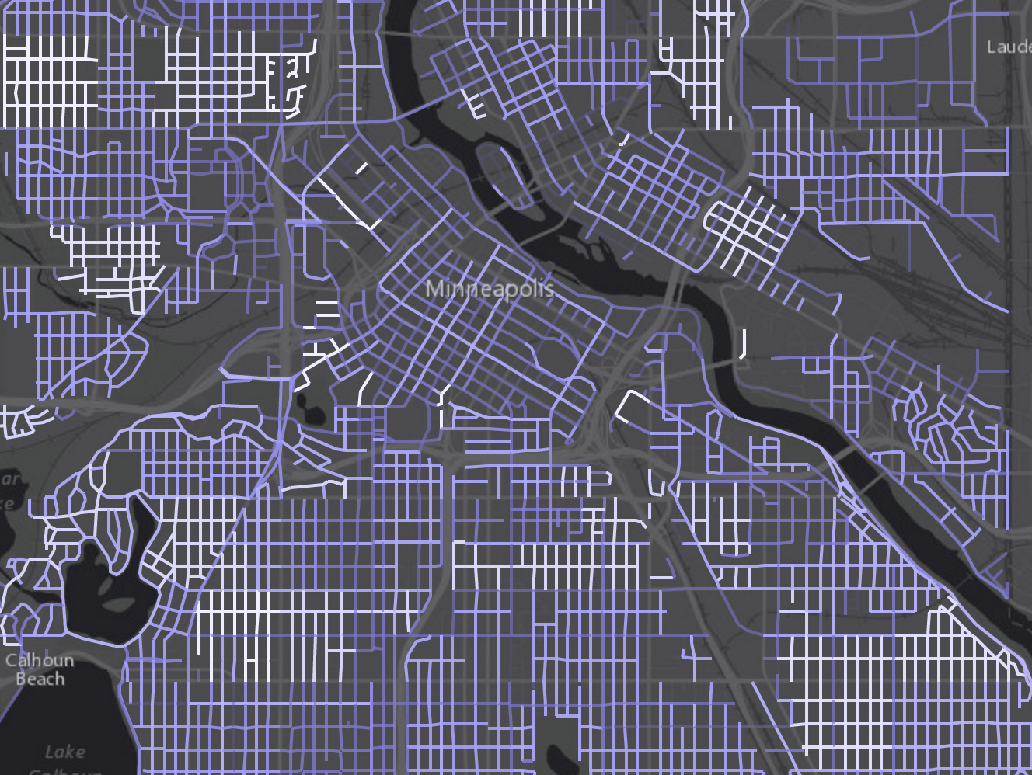
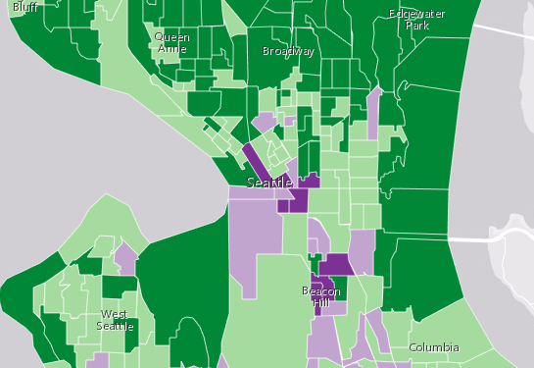
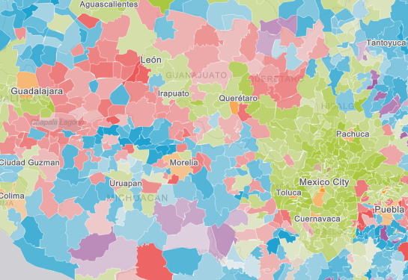
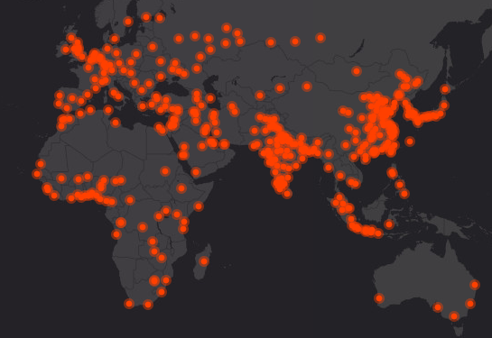


What can we visualize?
Where?
What?
How much?
When?
Multivariate

Slide 4
FeatureLayer
Data
MapImageLayer
CSVLayer
StreamLayer

Slide 5
Symbols
Notes:
G97350 UC Template for Esri staff

Slide 6
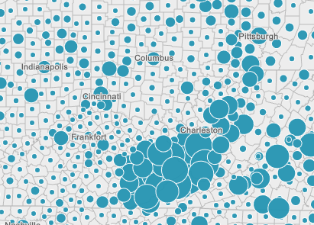
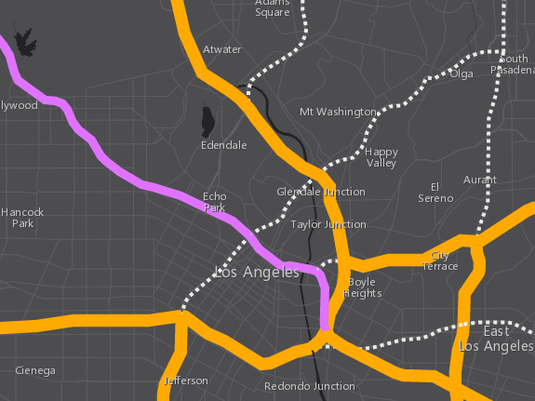
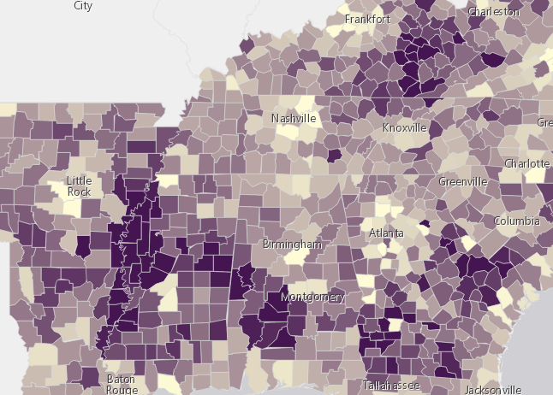
Symbols
based on geometry type
Points
Lines
Polygons
SimpleMarkerSymbol
SimpleFillSymbol
SimpleLineSymbol
PictureMarkerSymbol
PictureFillSymbol

Slide 7
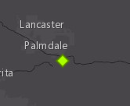
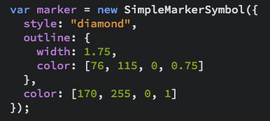
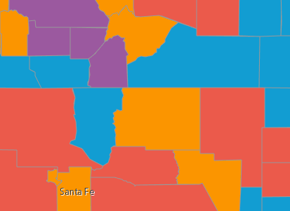
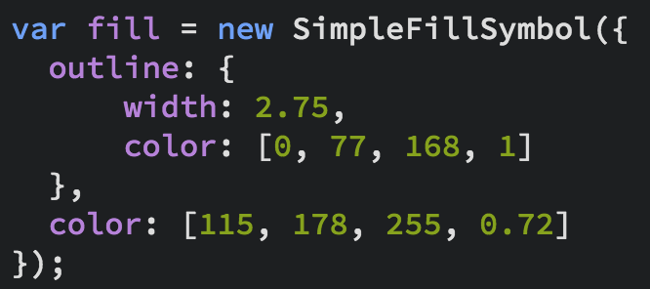
Symbols

Slide 8
Data-driven visualization
Field value(s)
TOTAL_POP
Arcade expression
Round( ($feature.BACHELOR + $feature.MASTER) / $feature.POP_25UP) );

Slide 9
Renderers
Notes:
G97350 UC Template for Esri staff

Slide 10
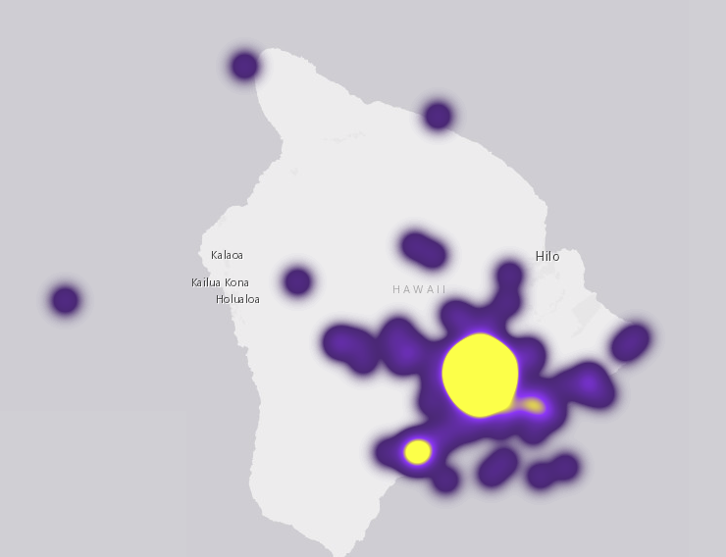
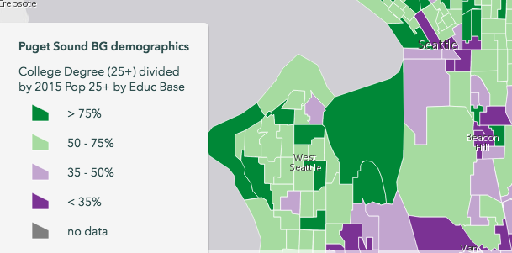
UniqueValueRenderer
Renderers
HeatmapRenderer
SimpleRenderer
ClassBreaksRenderer

Slide 11
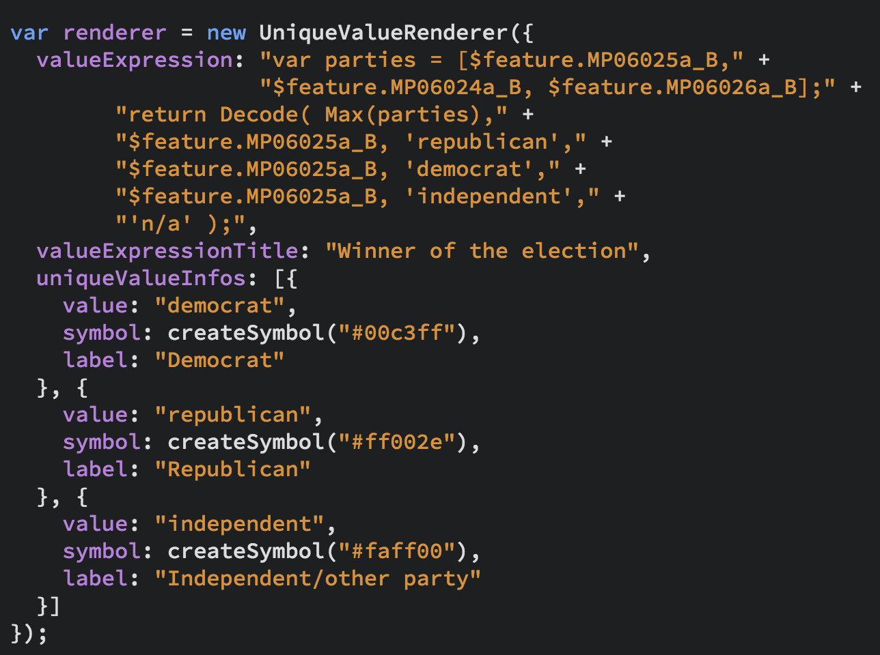
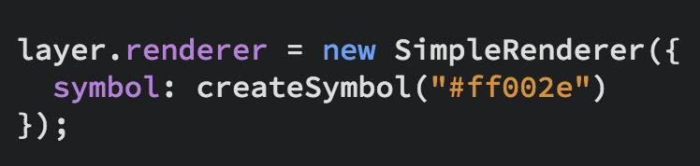
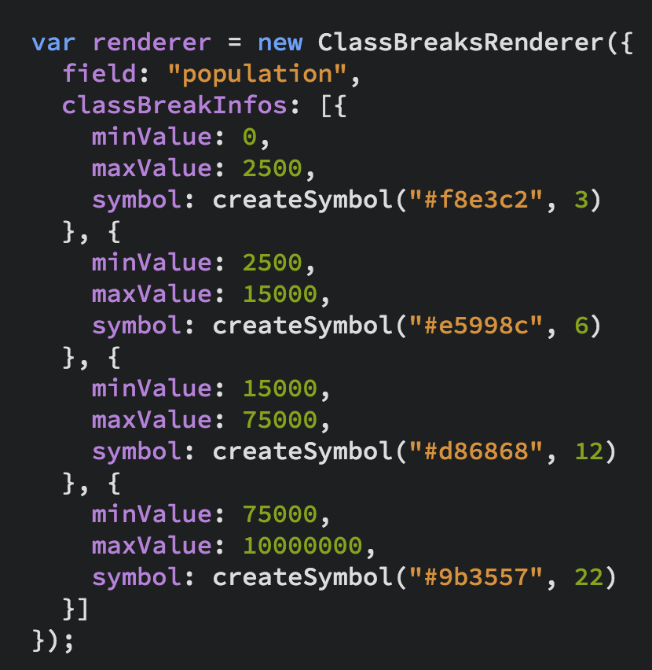
UniqueValueRenderer
Renderers
SimpleRenderer
ClassBreaksRenderer

Slide 12

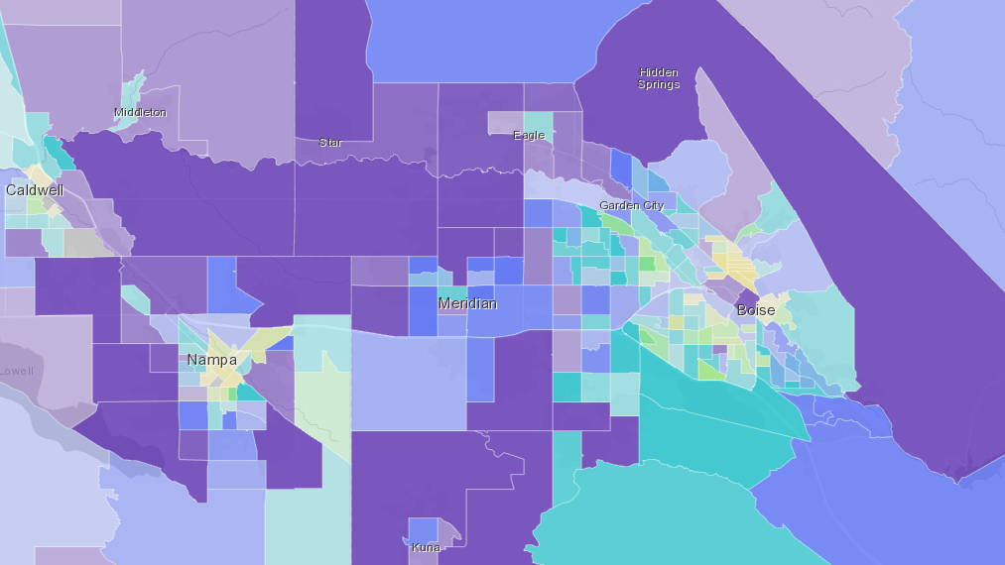
Examples
SimpleRenderer, UniqueValueRenderer, Predominance, Arcade Expressions

Slide 13
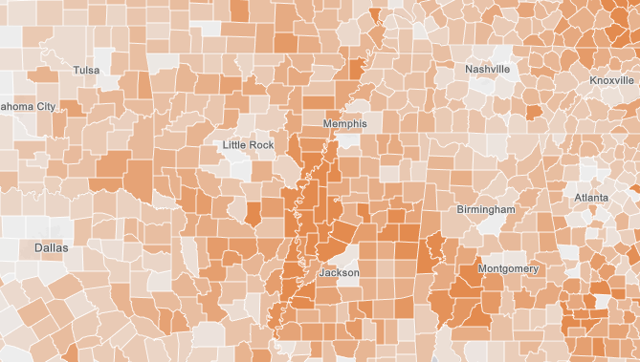
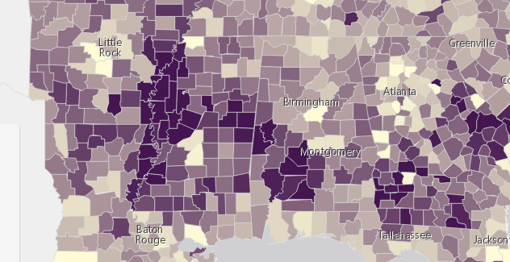
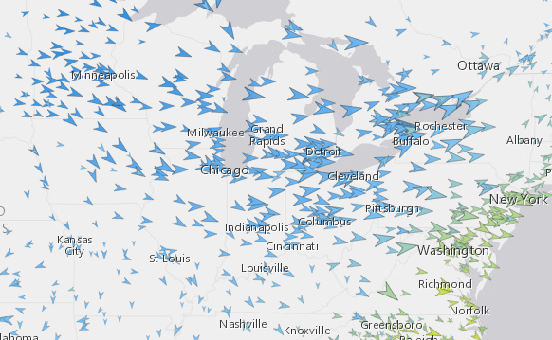
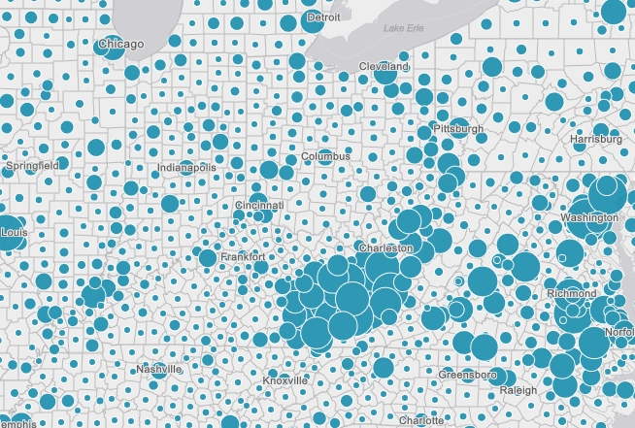
Renderers
Visual Variables
A property of the renderer
For numeric data-driven continuous visualizations
Color
Size
Opacity
Rotation

Slide 14
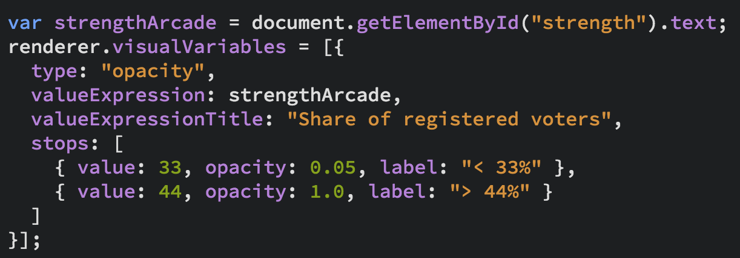
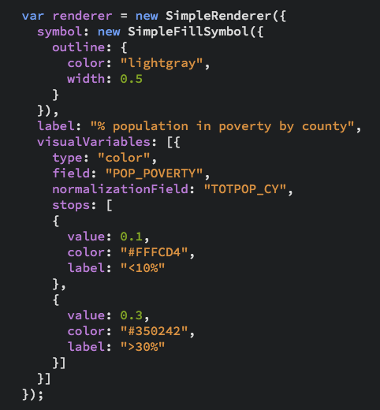
Renderers
Visual Variables

Slide 15
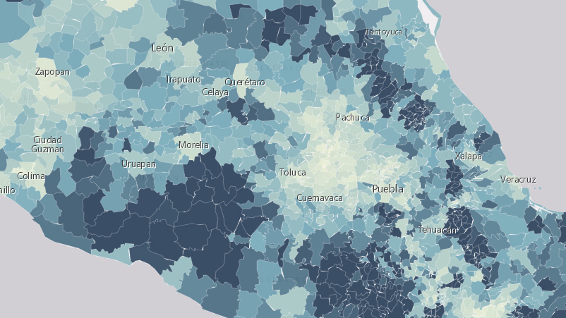
Visual Variables
Earthquakes, housing, elections, Smart Mapping

Slide 16
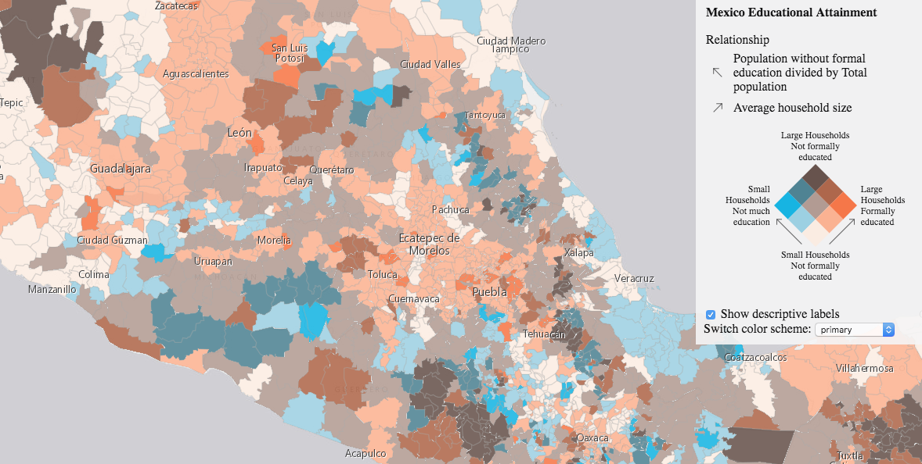
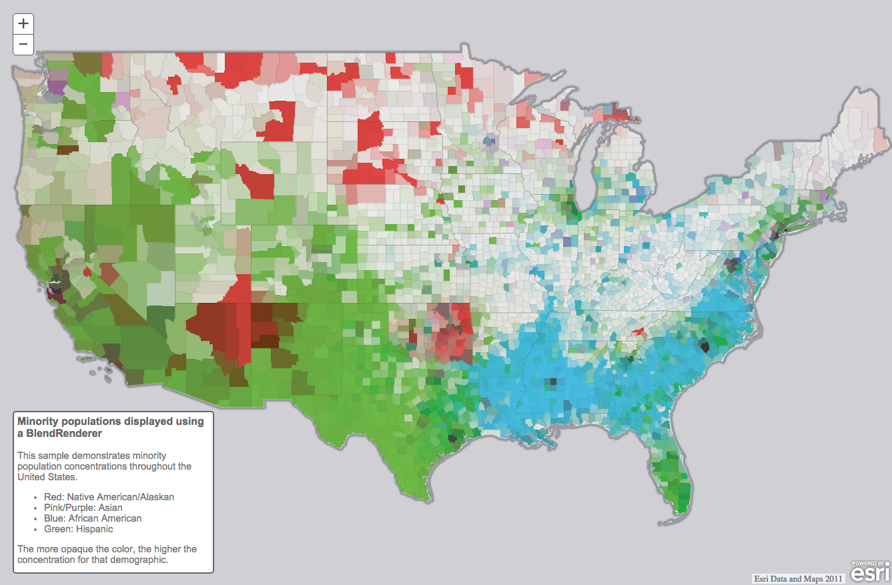
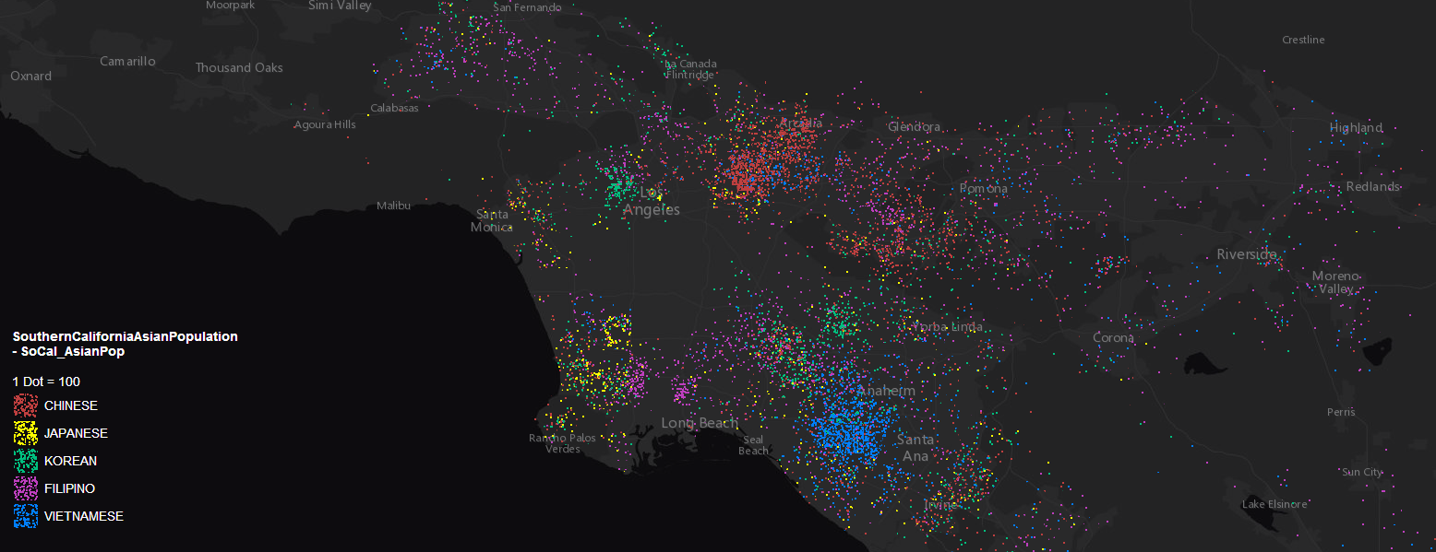
Renderers (3.x only)
Relationship
BlendRenderer
DotDensityRenderer

Slide 17
Relationships
% with Diabetes
% with Diabetes
% Obese
% Obese
https://go.esri.com/RelationshipMaps
Notes:
https://go.esri.com/RelationshipMaps

Slide 18
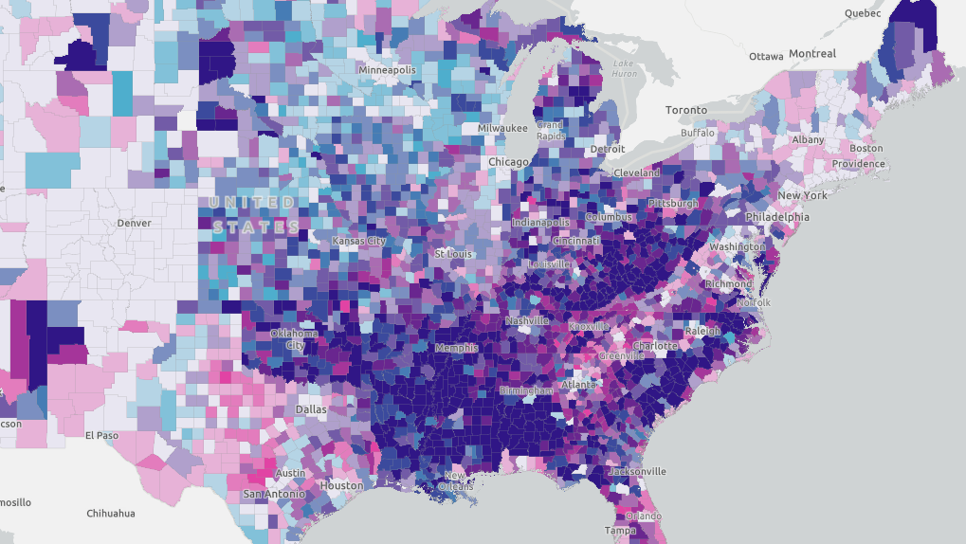
Relationships
Obesity, Diabetes, Inactivity

Slide 19
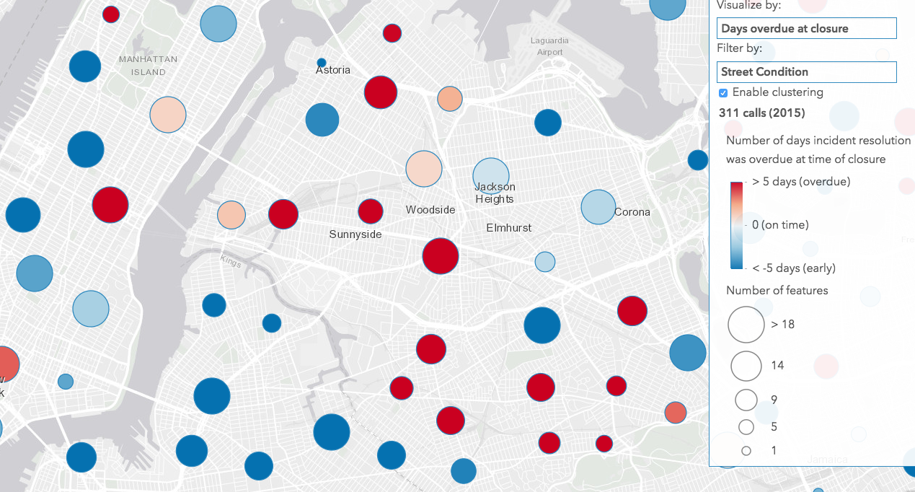
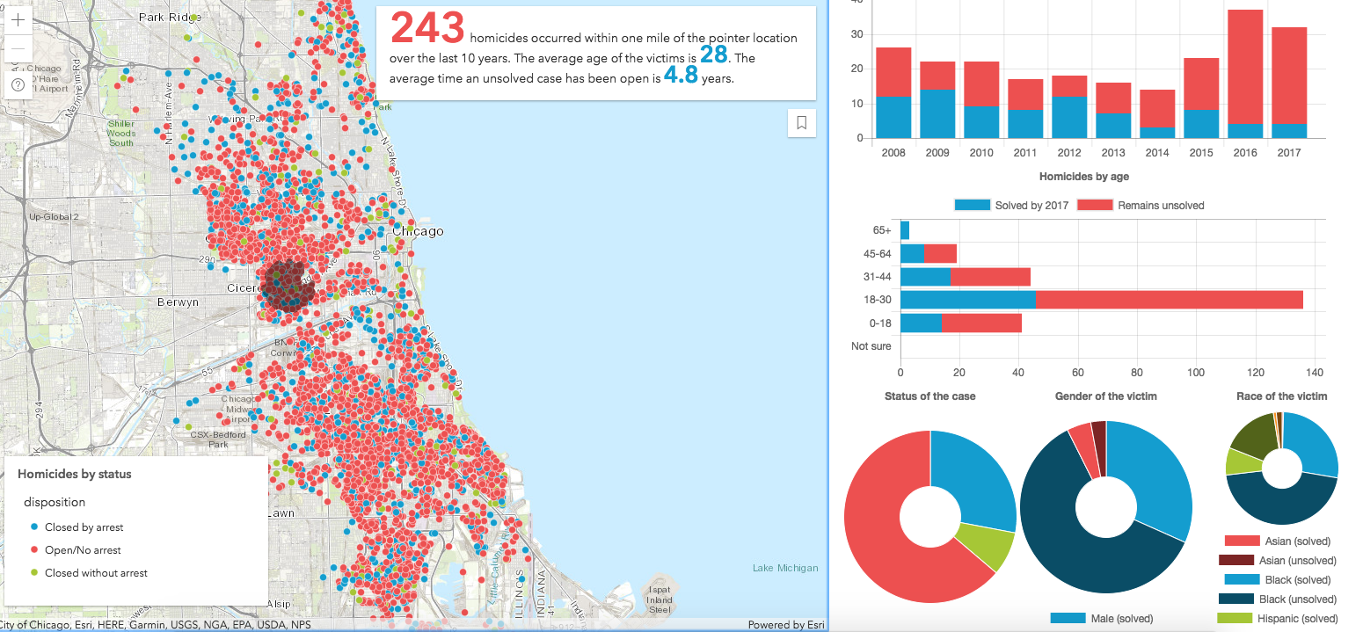
Visualize lots of points
Heatmap
Clustering
Display all of it!

Slide 20
FeatureLayer updates
More data can be displayed.
MaxRecordCount factor by tile
pbf queries reduce payload size
Reduced feature duplication
Faster drawing (first draw and final draw)

Slide 21
Client-side processing
Client-side queries, Fast visual variable updates, Clustering, Heatmap
Notes:
https://maps.esri.com/jg/Covenants/index.html
https://maps.esri.com/jg/HawaiiEarthquakeAnalysis/index.html
https://developers.arcgis.com/javascript/latest/sample-code/featurelayerview-query-distance/live/index.html
https://developers.arcgis.com/javascript/latest/sample-code/visualization-heatmap/live/index.html
https://developers.arcgis.com/javascript/latest/sample-code/visualization-heatmap-scale/live/index.html

Slide 22


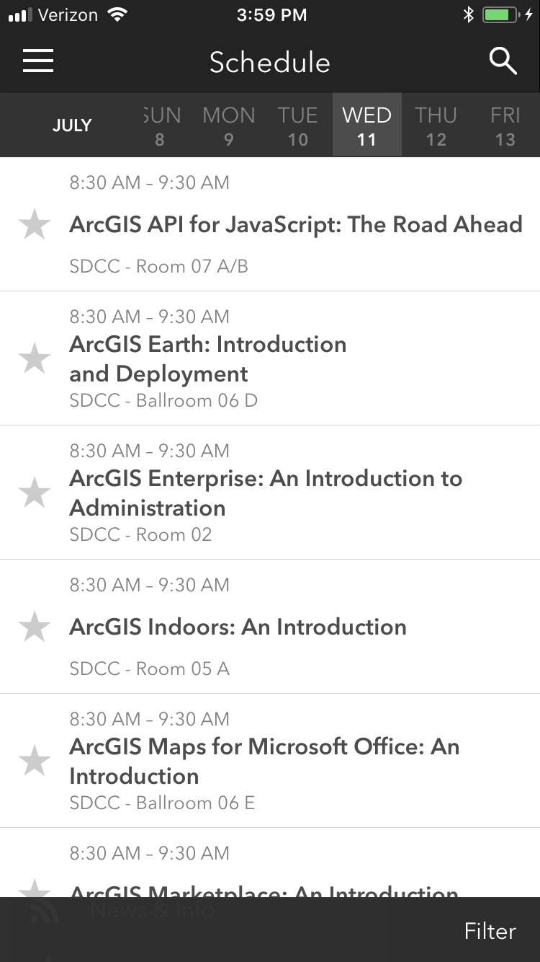
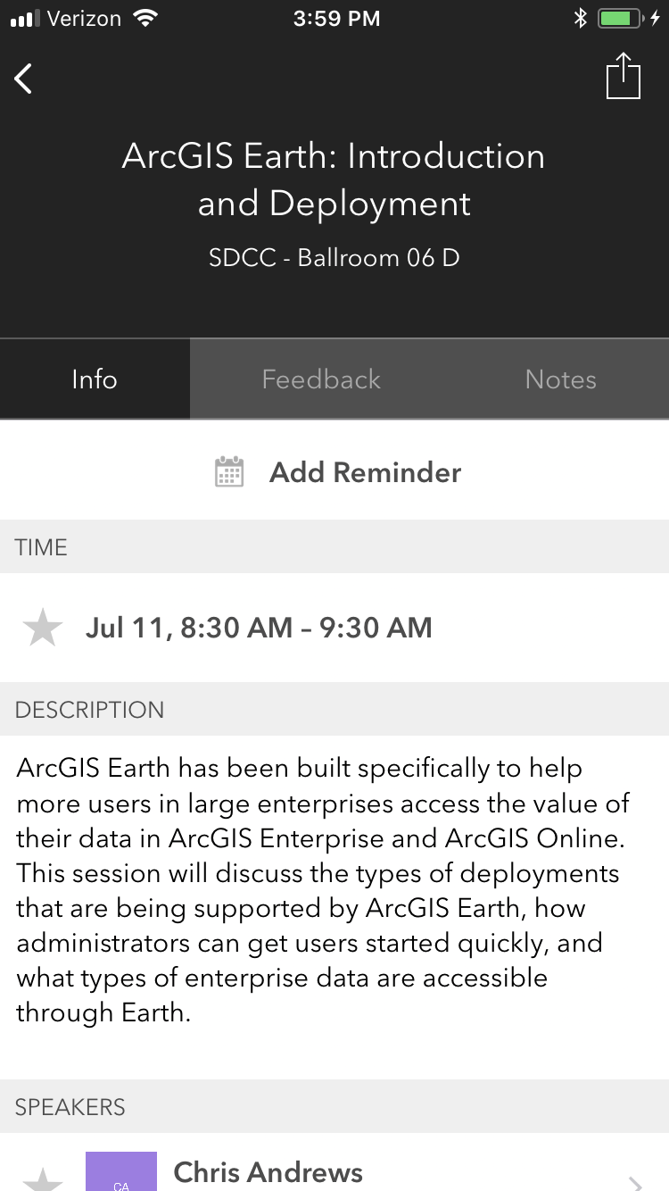
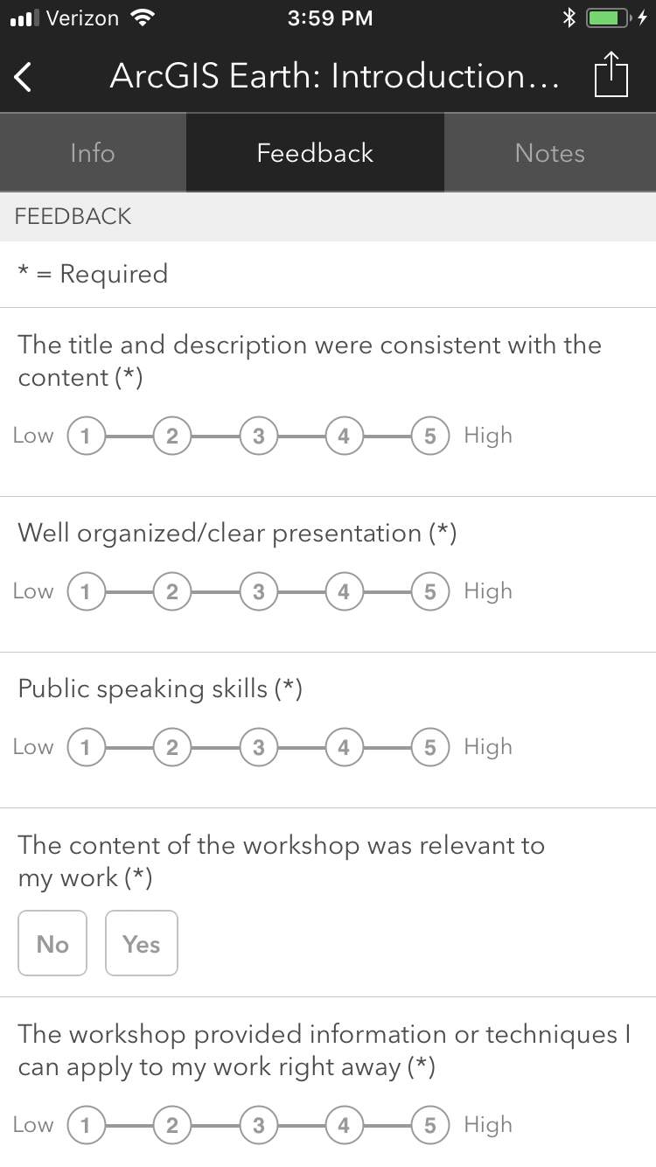


Please Take Our Survey on the App
Download the Esri Events app and find your event
Select the session you attended
Scroll down to find the feedback section
Complete answers
and select “Submit”

Slide 23
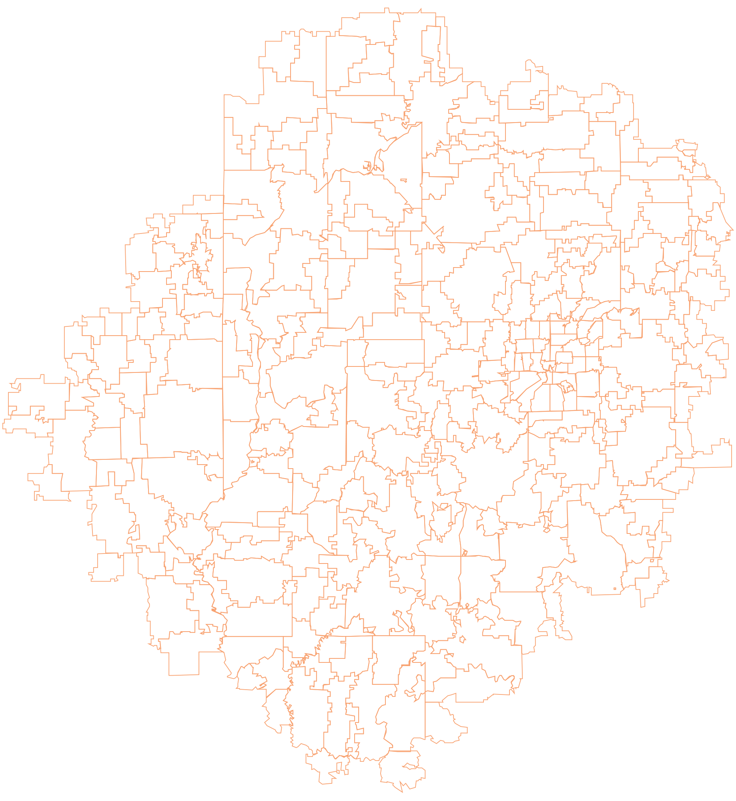


Notes:
G97350 UC Template for Esri staff

